Slide 1
Research Progress
01/08/2022
Sean Oldenburger

Slide 2
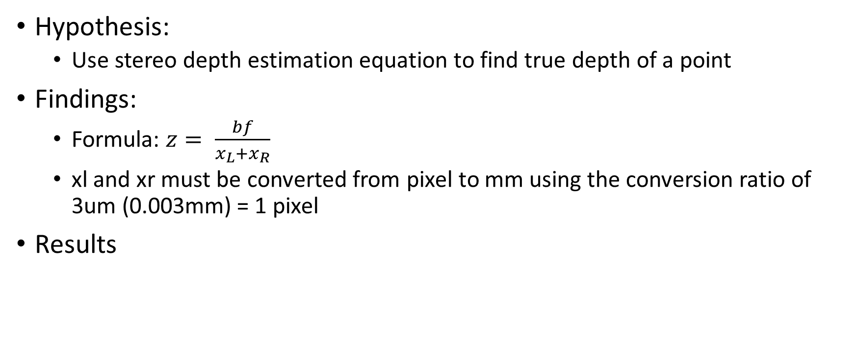
Stereo Depth Estimation
Hypothesis:
Use stereo depth estimation equation to find true depth of a point
Findings:
Formula: $z= \frac{bf}{x_{L}+x_{R}}$
xl and xr must be converted from pixel to mm using the conversion ratio of 3um (0.003mm) = 1 pixel
Results
xl | xr | Found Depth (mm) | True Depth (mm)
374 | 282 | 349.64 | 200
345 | 326 | 1693.0 | 1000
322 | 310 | 2680.6 | 1500
Ratio of 1.7 between True and Found
For correct predictions pixel to mm ratio must be ~5.3um
Or b or f are wrong

Slide 3
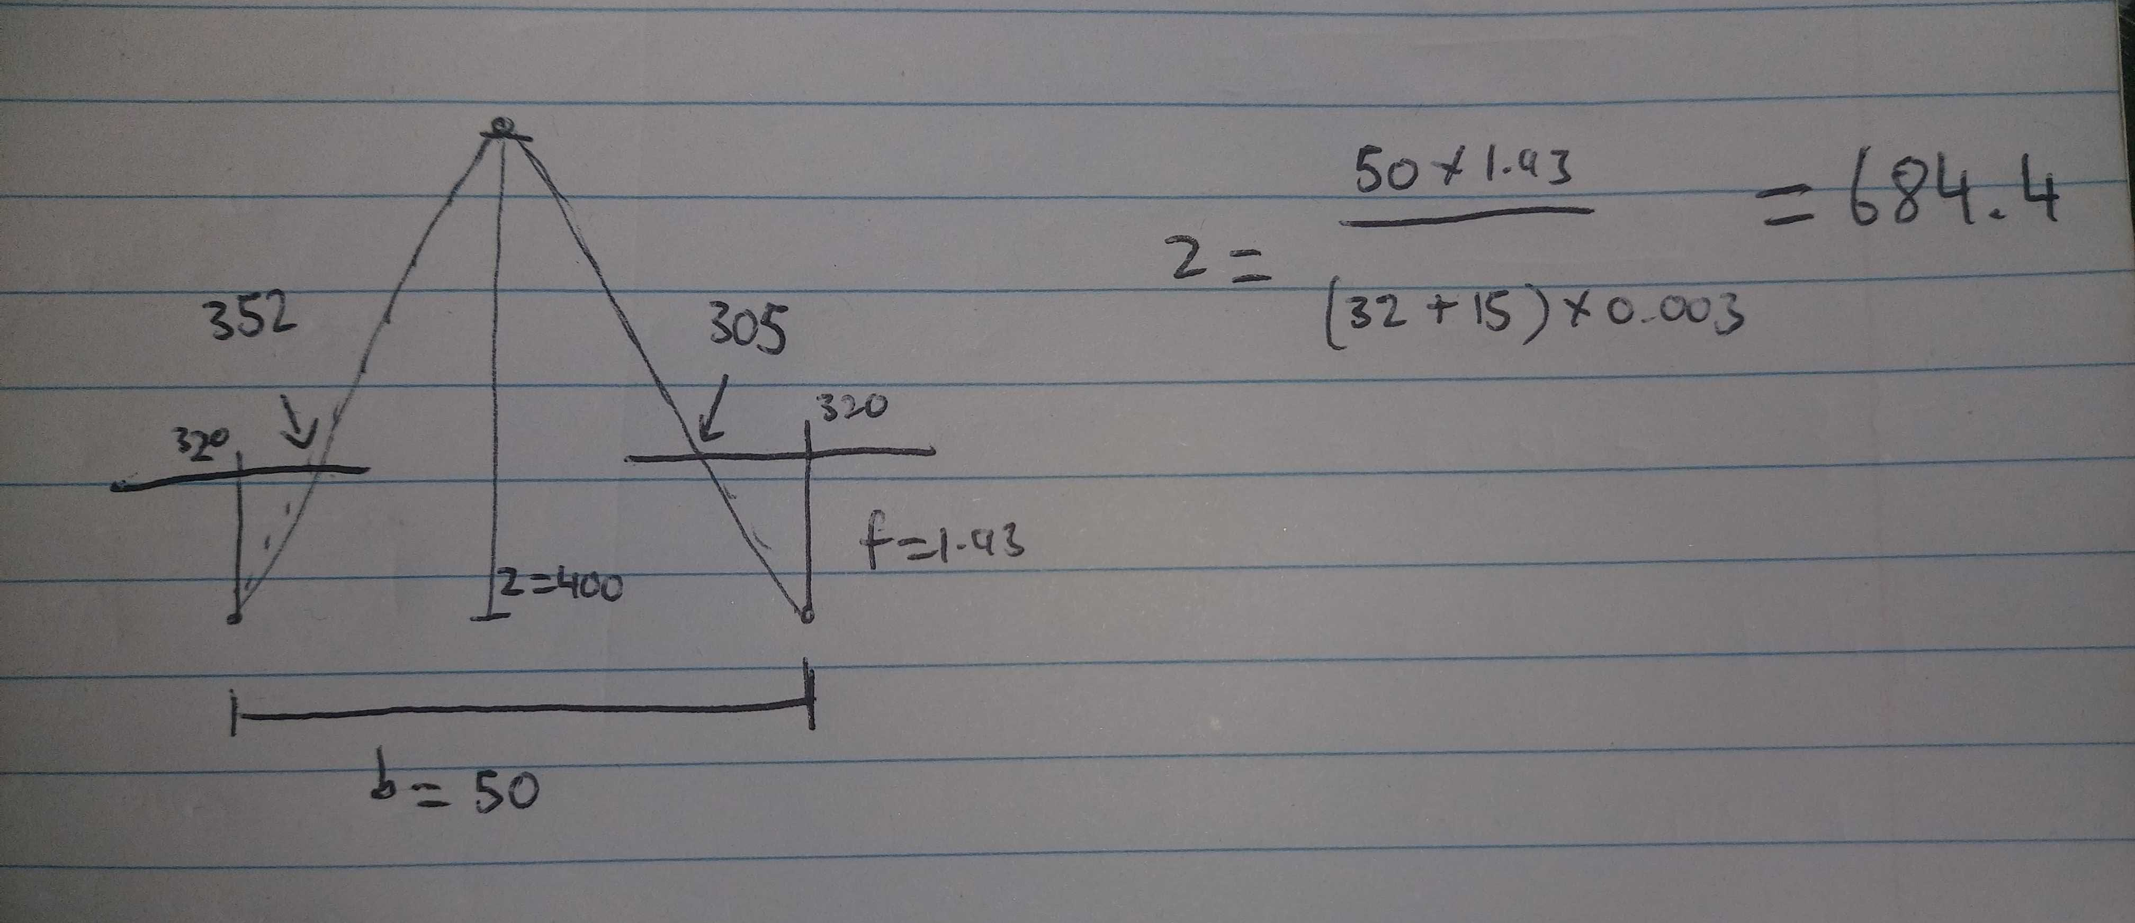
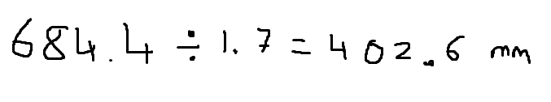
Example of Depth Estimation

Slide 4
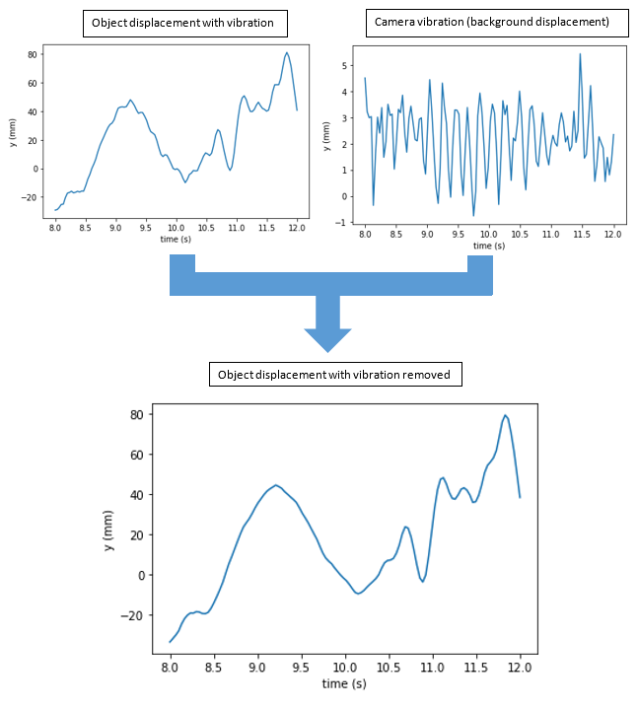
Point Vibration Removal using Camera Pose
Hypothesis:
Find an object and background point and remove the background vibration from the object point movement to find true movement of object
Findings:
This method only works with translation, doesn’t take rotations into account
If rotations occur the results begin to change very quickly
Results:
Next slides

Slide 5
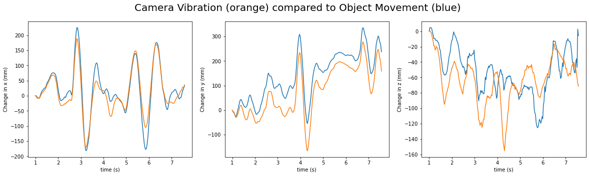
Results
For testing camera movement, I tracked the movement of 2 stationary objects at different depths.
The following graphs show that even though these 2 points are stationary they both return different camera movements
Yes, the 2 points will have different changes in pixels but when converted to true scale (mm) using depth information from stereo setup the results are comparable
However, the results are slightly different, and this is due to rotation of the camera, effecting the depth to points

Slide 6
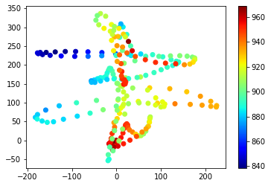
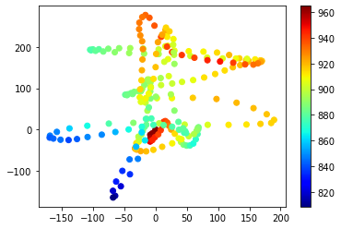
Results
From the graphs on last page, these are the 2 object point paths, showing they share very similar paths due to both being stationary objects
Proving that they should return the same change in x, y and z movements, however they did not due to camera rotation

Slide 7
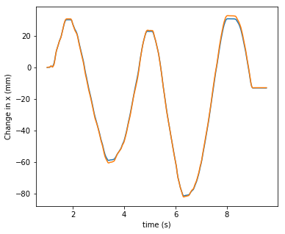
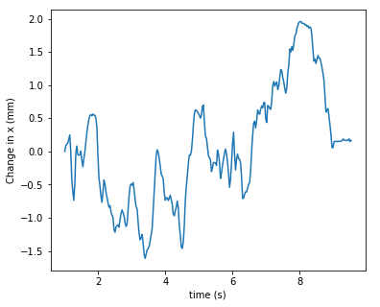
Results
To prove that this error is due to rotation I conducted an experiment with constraint variables (camera movement was parallel to the 2 stationary objects and moved along the x coordinate, no rotation)
As we can see the results are now very accurately the same
Error between 2 points

Slide 8
Video Vibration Removal using Stabilization
Hypothesis:
Alter the entire video instead of finding one background point using stabilization techniques
Findings:
Much more affective than previous method, previous method could work if rotation is figured out but that is a lot of hassle and I’m not sure how to do that yet
This method is easy to implement, and results so far have been promising
Results:
Next slides

Slide 9
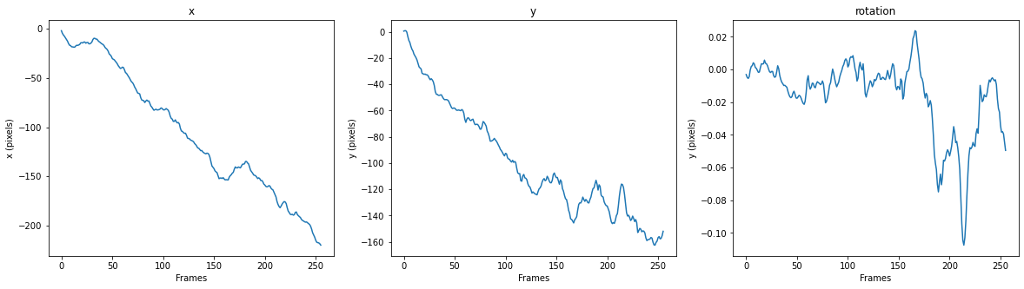
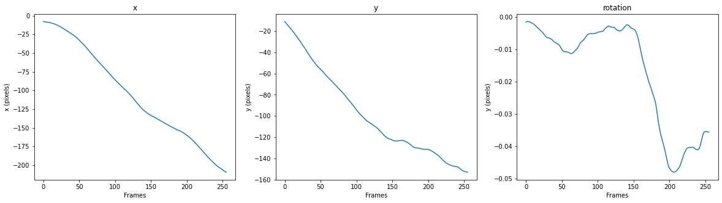
Results
2 methods: remove movement of the video completely or remove the vibration and create a smoother path of movement
The second method makes more sense for a stationary drone with slight vibration and will therefore use this method, however, below are some vibration removal results in the x and y directions

Slide 10
Results
Cannot show results on PowerPoint as much, view some video results I have saved for better results
Vid3 -> good stabilization (vid3-stable2)
Vid6 -> good stabilization with moving object (vid6-stable2)
Vid5 -> example of limitations of the model (vid5-stable2)
Limitations are due to stabilization in only 2D
Next step is to find 3D stabilization and compare results

